Slide 1

Mastering Data Quality Validation in Fabric for Power BI Reports
Kristyna Ferris
Please grab some swag!

Slide 2

About Me ~ Kristyna Ferris
Microsoft MVP, Data Platform & Fabric Solution Architect, P3 Adaptive Lexington Data Tech Group co-organizer Co-author on DataOnWheels Co-founder of Data On Rails
Blog - https://dataonwheels.wordpress.com/ LinkedIn - https://www.linkedin.com/in/kristyna-ferris-dataonwheels/
Twitter - @data_dragoness

Slide 3


Data Quality – Building Trust
The key to useful reporting is adoption.
Consistently incorrect data destroys trust in the data and the report by extension.
The quickest way to rebuild trust is to automate data quality checks and demonstrate ability to catch errors before end users.

Slide 4
Why Python?
Notes:
Don’t be afraid to try this yourself!
An F2 capacity is very cheap, especially if you pause it when you’re not using it.

Slide 5

Why Python?
Notes:
Don’t be afraid to try this yourself!
An F2 capacity is very cheap, especially if you pause it when you’re not using it.

Slide 6

Fabric Demo Set Up & Limitations
1. Fabric Capacity
2. Add data to Fabric Lakehouse
3. Connect to data from Fabric in PBI Desktop
4. Create notebook in Fabric to run data quality check

Slide 7
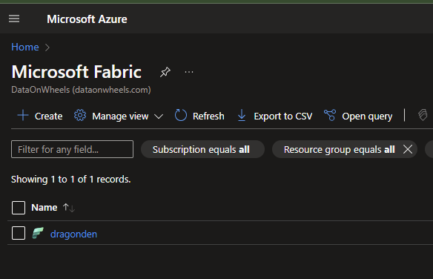
Creating a Fabric Capacity
Navigate to the Azure Portal
Create a subscription (contains all the payment details)
Create a resource group (can be useful for billing)
Create Microsoft Fabric capacity

Slide 8
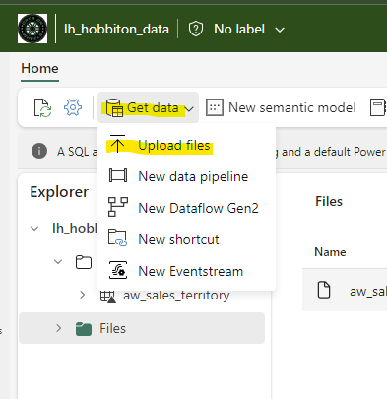
Adding Data into Fabric
Lots of options!
Notebooks
Dataflows
Pipelines
Upload files
For our demo, we are using a simple CSV upload into a Lakehouse. Not recommended for production, but perfect for POCs.
Notes:
To use the upload option, make sure to use CSV with no spaces in the header column.

Slide 9
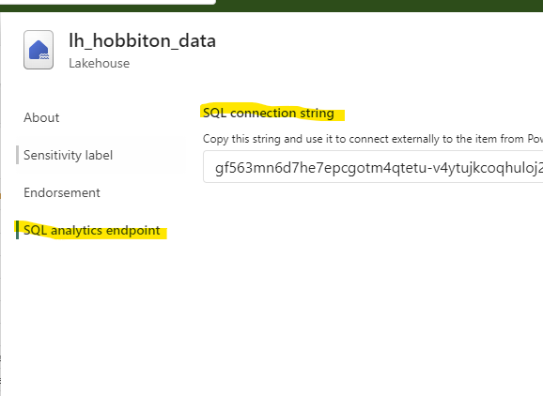
Connect to Data from Fabric in PBI
Very similar to connecting to a SQL Server.
Grab the SQL connection string from the lakehouse.
Use the SQL Server Database connector in Power BI with that connection string as the server.
Use Microsoft Account as the login credentials.

Slide 10

Notes:
Steps –
Fabric Capacity creation, upload data into a lakehouse, connect to data in Power BI desktop, publish, create notebook
Notebook steps – import libraries, connect lakehouse, create dataframe with the metrics to test, create execute dax measure simple, create execute sql query simple, show how to loop

Slide 11

Don’t forget to connect, thanks for listening!
https://dataonwheels.wordpress.com/
kristyna@dataonwheels.com
@data_dragoness
GitHub

